Slide 1
Discovery Education (DE)
Fall 2013
Notes:
Two week for scores from the time you send it in.
Get Munis Employee ID from Terry
Discovery Ed is replacing core K-12 and FAIR
This training will be a snap shot of what we need now.
There will be further training later about how to pull data.

Slide 2
PASCO’S INTEGRATED SYSTEM
MTSS: One Integrated Framework
Standards-Based Instruction
Professional Growth System
*CCSS
and
NGSSS
Effective Instruction
and
Leadership
PLC
Professional Learning
Notes:
It is important that all programs support and align with our district initiatives. We are developing and supporting our people. We will build a professional growth system to elevate and improve the teaching profession. In order for teaching practices and student outcomes to improve, teachers have to play a main role in holding their colleagues responsible and helping them get better.
And it is not just about individual success. It’s about team success. That’s why we are committed to building strong professional learning communities.
Our district is implementing CCSS. The bottom line is that a well-trained and highly supported work force will better be able to serve our students and provide the interventions and guidance students need to be successful.

Slide 3
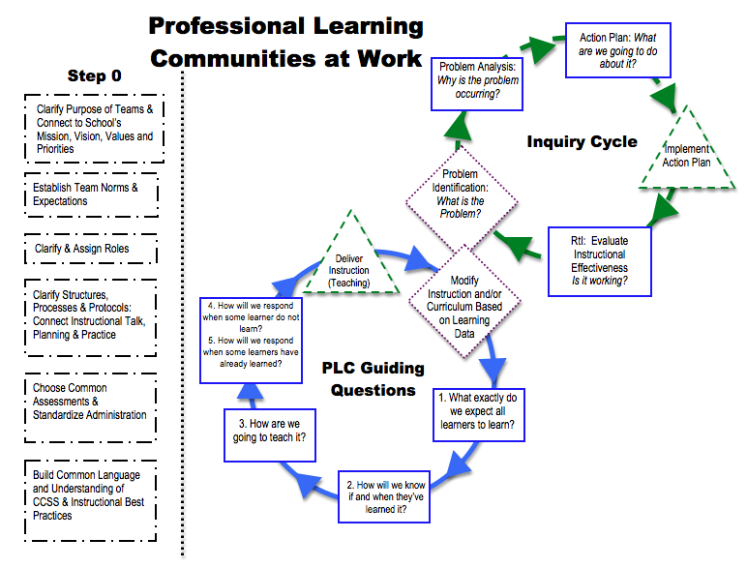

Slide 4
Purpose
Discovery Education provides a platform to let us know how students are doing on their mastery of the standards.
Student Growth (Vision)
Connection to Common Core (standards-based instruction)
Guides planning of instruction (PLC)
Allows for planning for next year (PLC)
Allows for reflection on instruction (professional growth system)
Notes:
Review the purpose and how it connects to the district initiatives.
We don’t expect to see 100% mastery.
The focus is on Growth for all kids.

Slide 5
Assessment Audiences
Classroom (Student, Teacher, Parent)
Instructional Planning-spend more or less time on a skill
Remedial
Enrichment
School or Program
School strengths and weakness
District curricular needs
Institutional
Accountability
Stiggins, R. (April 2008). Assessment manifesto: A call for the development of balanced assessment systems. ETS Assessment Training Institute. Portland: OR.
Notes:
There are three key audiences to assessments. Each is important and serves a specific function. Lets looks at the differences between each.

Slide 6
Differences
Classroom: serves the student (Am I able to be successful?)
Program: faculty examines professional effectiveness of instructional interventions to master pre-determined standards
Institutional: matters of leadership effectiveness, instructional policy, resource allocation
Stiggins, R. (April 2008). Assessment manifesto: A call for the development of balanced assessment systems. ETS Assessment Training Institute. Portland: OR.
Notes:
Review the slide. The next slides will look at these types of audiences individually allowing us a deeper look.

Slide 7
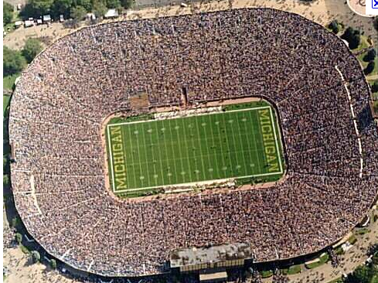
Assessment Purpose: Institutional
Answers the question
Are our schools as effective as they need to be?
Serves summative, accountability purposes
Examples: FCAT 2.0, EOC, Unit Test
Stiggins, R. (April 2008). Assessment manifesto: A call for the development of balanced assessment systems. ETS Assessment Training Institute. Portland: OR.
Notes:
This is the big picture FCAT. This is not the purpose of Disc. Ed.
The Assessment Purpose for the Institutional Audience is the 30,000 foot view. Think about looking at a football game from a blimp. You can see the overall structure of the game but you cannot see the plays nor the players. This level provides a look at the school as a whole and lets us know if our schools are as effective as they should be.
Think of this type of assessment as the Final Superbowl Score.

Slide 8
Assessment Purpose: School or Program
Answers the questions
Which standards are our students mastering or not mastering?
How might our programs be improved to promote greater student success?
Identify aspects of instructional program working or in need of improvement
Interim, benchmark, short-cycle, common assessments every few weeks
Focus: achievement standard
Stiggins, R. (April 2008). Assessment manifesto: A call for the development of balanced assessment systems. ETS Assessment Training Institute. Portland: OR.
Notes:
The Assessment Purpose for the School or Program Audience is the 1,000 foot view. Think about looking at a football game from the press box. You can see the plays of the game but you cannot see the players. This level provides a look at the programs in the district or at the school. It answers the questions of Which standards are our students mastering or not mastering? And how might our programs be improved to promote greater student success?
This information is useful for a school to progress monitor school improvement goals. It also provides useful information about programs implemented in the school or district tied to our district initiatives: PLCs and Leadership Team discussions.
This will be our focus for today’s training.

Slide 9
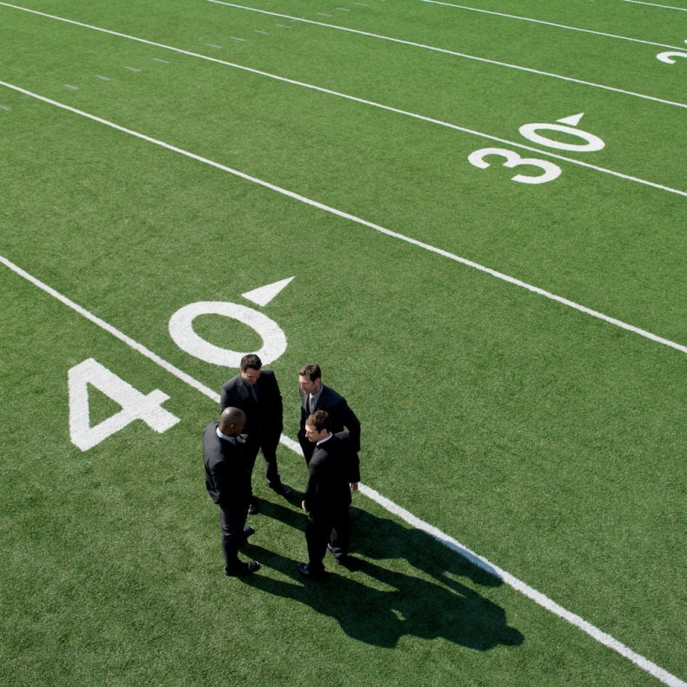
Assessment Purpose: Classroom
Answers the questions
What comes next in the learning?
How is each student doing on his or her journey up the scaffolding leading to each standard?
Must provide information continuously
Focus: Each individual student
Stiggins, R. (April 2008). Assessment manifesto: A call for the development of balanced assessment systems. ETS Assessment Training Institute. Portland: OR.
Notes:
How does this fit in with PLC? IRLA? Curriculum unit maps?
The Assessment Purpose for the Classroom Audience is the 10 foot view. Think about looking at a football game as the coach on the field. You can see the players and the interworking of the plays as they are implemented. This level provides continual look at each student. It answers the questions of What comes next in the learning? And how is each student doing on his or her journey up the scaffolding leading to each standard?
For this level, we would create a probe or mini assessment from the item bank within DE. This will be our focus for a future training.

Slide 10
Think About IT…
Summative
Formative
FCAT 2.0
End-of-Course
Unit Test
Chapter Test
DE Benchmark Assessment
DE Mini Assessment (Probes created from Item Bank )
Fist to Five
IRLA
Notes:
Look at these assessments. What information about your students would you get from each of these?
Summative assessment practices measure what was learned
Formative assessment practices guide instruction and progress monitor

Slide 11
Expectations for DE
Notes:
DE is a comprehensive tool that can provide you a great deal of information related to how your students as a whole and as an individual are doing in the learning. The tool also provides resources that can be used for instruction including small group or individual learning. However, this will be a journey. It will take us several months perhaps two years for us to know all that can be used once you are proficient with DE.
Items that look at content you taught and you haven’t taught. Over time, you will find ways to use all of this information to help you help students growth from where they come to you. It will also provide you useful information that can be used to guide instruction and to have professional conversations with colleagues on your team and within your school to ensure you have what you need to make the right decisions.
As we begin our journey, we are using the benchmark assessments. Some of you will want more information since benchmarks are broad measuring several standards with fewer questions per standard. You will want more information per standard. This is something DE will be able to provide. However, that will be addressed at a future training.

Slide 12
How will we teach it?
This year the district has prioritized three of the six instructional shifts to increase the rigor of our work:
Writing to sources
Text Based Answers/Evidence Based Discussions
Staircase of Complexity
Notes:
This is what our PLC focus needs to be.

Slide 13
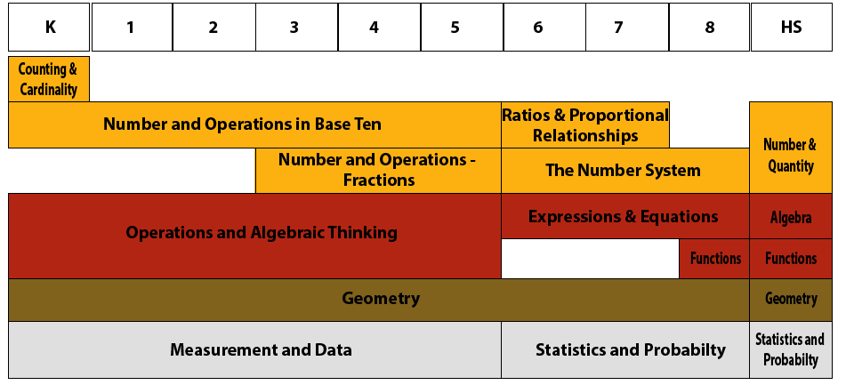
CCSS Mathematics
Notes:
The progression describes the sequence of increasing sophistication in understanding and skill within an area of study. The diagram illustrates how the domains are distributed across the Common Core State Standards for Mathematics.

Slide 14
Logistics
Initial Training:
Data analysis for BOY during planning
Testing Time Line
BOY Benchmark- Sept. 3- Sept. 27
Benchmark 2- Nov. 18- Dec.20
Benchmark 3- Feb. 10- March 13
EOY Benchmark May 1- May 23 (non EOC tested courses)

Slide 15
Overview of Next Steps related to Training
Student Logistics
Student logins
Assigning benchmark test to students
K, 1 Practice Test
Comparative Report
Additional Reports
Creation of Probes and mini assessments

